Slide 1
Mining Association Rules
From Association Mining to Correlation Analysis

Slide 2
Association and Correlations
Association and Correlations
Efficient and Scalable Frequent Itemset Mining Methods
Mining Various Kinds of Association Rules
From Association Mining to Correlation Analysis
Constraint-based Association Mining

Slide 3
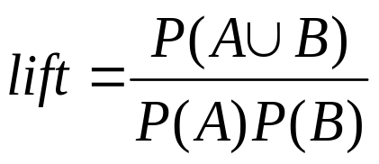
兴趣度量: 相关（提升度）
打篮球 ⇒吃谷物[40%, 66.7%] 是误导
学生吃谷物的全部百分比是75% ，这比66.7%要高。
打篮球 ⇒ 不吃谷物[20%, 33.3%]更精确些，虽然只有低的支持和可信度
相关事件的衡量: 提升度（lift）
 | Basketball | Not basketball | Sum (row)
Cereal | 2000 | 1750 | 3750
Not cereal | 1000 | 250 | 1250
Sum(col.) | 3000 | 2000 | 5000

Slide 4
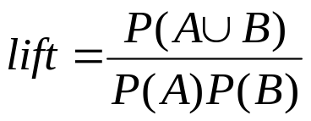
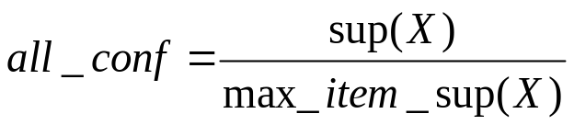
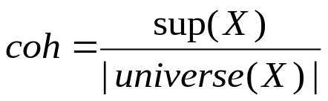
所有发现的关联规则都是有趣的吗?
“买胡桃 ⇒ 买牛奶[1%, 80%]” 是误导的
如果85%的客户买牛奶
支持和可信度不能很好的代表相关性
So many interestingness measures? (Tan, Kumar, Sritastava @KDD’02)
 | Milk | No Milk | Sum (row)
Coffee | m, c | ~m, c | c
No Coffee | m, ~c | ~m, ~ c | ~c
Sum(col.) | m | ~m | Σ
DB | m, c | ~m, c | m~c | ~m~c | lift | all-conf | coh | χ2
A1 | 1000 | 100 | 100 | 10,000 | 9.26 | 0.91 | 0.83 | 9055
A2 | 100 | 1000 | 1000 | 100,000 | 8.44 | 0.09 | 0.05 | 670
A3 | 1000 | 100 | 10000 | 100,000 | 9.18 | 0.09 | 0.09 | 8172
A4 | 1000 | 1000 | 1000 | 1000 | 1 | 0.5 | 0.33 | 0

Slide 5
挖掘高度关联的模式
lift 和 χ² 在事务数据库中并不是好的相关性度量
all-conf or coherence could be good measures (Omiecinski @TKDE’03)
Both all-conf and coherence have the downward closure property
Efficient algorithms can be derived for mining (Lee et al. @ICDM’03sub)
DB | m, c | ~m, c | m~c | ~m~c | lift | all-conf | coh | χ²
A1 | 1000 | 100 | 100 | 10,000 | 9.26 | 0.91 | 0.83 | 9055
A2 | 100 | 1000 | 1000 | 100,000 | 8.44 | 0.09 | 0.05 | 670
A3 | 1000 | 100 | 10000 | 100,000 | 9.18 | 0.09 | 0.09 | 8172
A4 | 1000 | 1000 | 1000 | 1000 | 1 | 0.5 | 0.33 | 0

Slide 6

Which Measures Should Be Used?

